Slide 1

Exploratory Data Analysis and Visualization of New York City Airbnb Listings – 02/17/21
Kapil Pundhir, Hillary Mandich, Cecilia Leung, Amaris Hassan, Caitlan Beachey

Slide 2


Introduction
Airbnb has over 7 million listings and over 2.9 million hosts worldwide
Airbnb is available in over 100, 000 cities, but the United States alone holds the highest number of listings of any country in the world
New York City (NYC) is one of the most visited tourist attractions globally, a major center of the entertainment industry, and the world’s leading financial center
With these factors in consideration, it comes as no surprise that NYC is also one of the top three most popular cities used on Airbnb

Slide 3
Exploratory Questions
What are the different types of properties in NYC?
Does property type availability vary by neighbourhood?
What neighbourhoods in NYC are rated highly by guests?
How do prices of listings vary by location?
How has the demand for Airbnb rentals evolved over time?
Notes:
The aim of our project’s analysis is to answer the following questions:
What are the different types of properties in NYC?
Does property type availability vary by neighbourhood?
What neighbourhoods in NYC are rated highly by guests?
How do prices of listings vary by location?
How has the demand for Airbnb rentals evolved over time?

Slide 4
Analysis of Data Quality
Data Sourced from Inside Airbnb (http://insideairbnb.com/get-the-data.html ) which hosts publicly available data from the Airbnb site
Available CSV and GeoJson files that outline data on listings, availability calendars, reviews, and neighbourhoods
Listings.csv provided details on 36923 active listings in New York
Data comprised of 64 attributes covering listing amenities, listing availability, neighbourhood, host background, and reviews for each record
Notes:
-The data is sourced from the Inside Airbnb website http://insideairbnb.com/get-the-data.html which hosts publicly available data from the Airbnb site.
-Columns/features we were interested in did not contain data in the required format and hence were manipulated in a way that their meanings are retained.

Slide 5
Analysis of Data Quality
price : Column contained data in string format with the currency symbol ‘$’ and comma separator
host_response_time and host_response_rate : Columns contained data in string format with the percent symbol ’%’
host_is_superhost, host_identity_verified, has_availability, instant_bookable : Columns contained data ”t” and “f” in string format instead of Boolean.
Redundancy for listings availability data:
availability_30, availability_60, availability_90, availability_365, minimum_minimum_nights,
maximum_minimum_nights, minimum_maximum_nights, maximum_maximum_nights,
minimum_nights_avg, minimum_nights_avg_ntm, maximum_nights_avg_ntm
Notes:
-The data is sourced from the Inside Airbnb website http://insideairbnb.com/get-the-data.html which hosts publicly available data from the Airbnb site.
Data Munging
-Columns/features we were interested in did not contain data in the required format and hence were manipulated in a way that their meanings are retained.
Values in columns comprised of special characters (e.g. $, %, and ,) were standardized.
Needed to further reduce the size of dataset to meet free uploading requirements to postgres SQL.

Slide 6
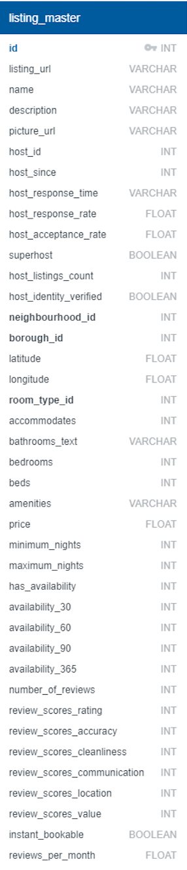
Final Dataset
Each listing represented by a unique Airbnb ID
Maintained information that would be most important when booking:
Location
Price
Room type/amenities
Listing availability
Guest Reviews
Host Rating

Slide 7
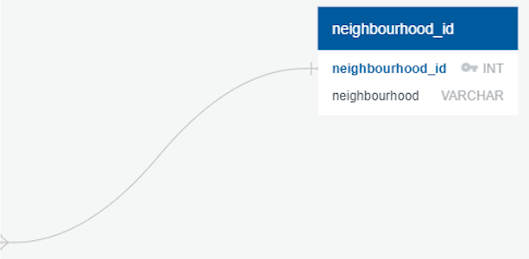

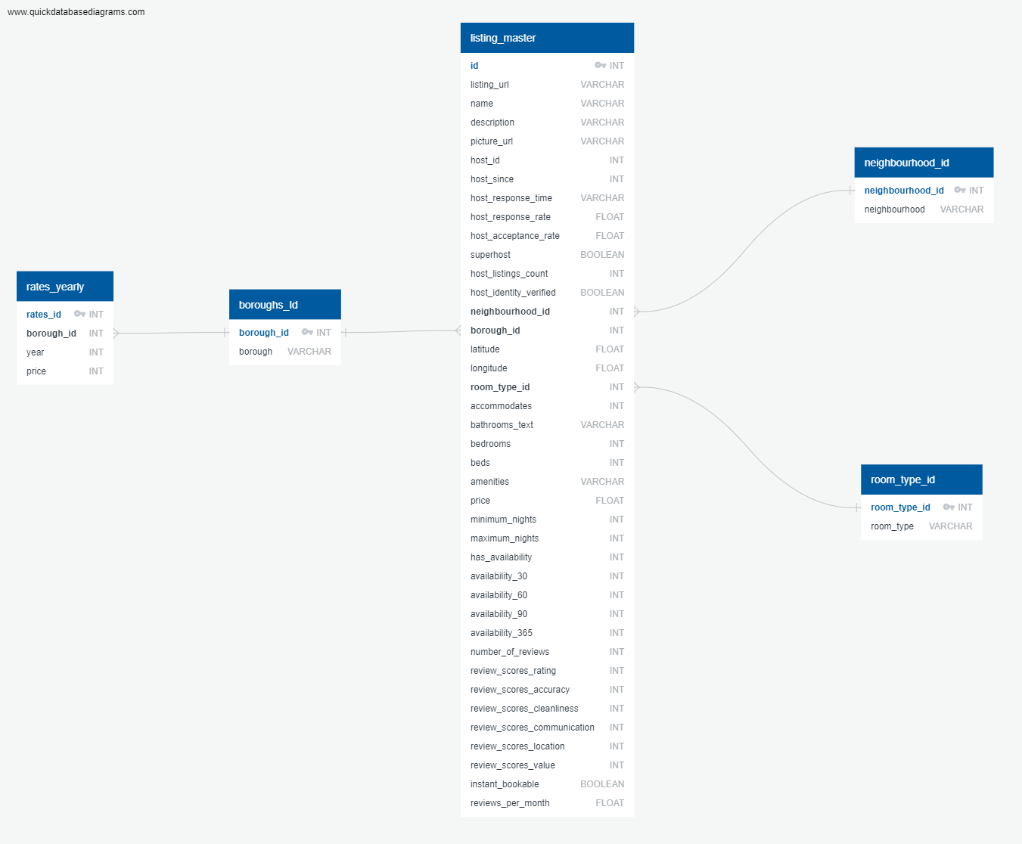
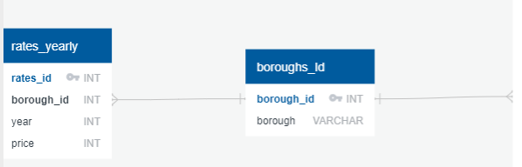
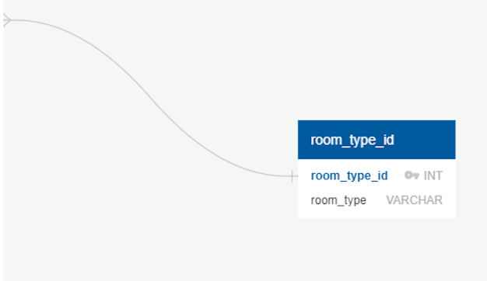
Relationship of Datasets
Notes:
*** Include screen shot of ERD Diagram
*Uploaded tables using Jupiter Notebook and Pandas
*Challenges:
* Had to create a new database and flask database
*Elephant SQL – Original data set was too large when we tried to load
*Used Elephant SQL to connect to postgres SQL
(Kapil and Hilary)

Slide 8
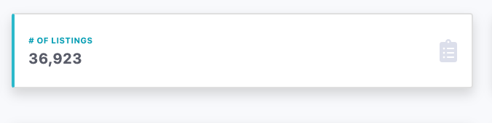
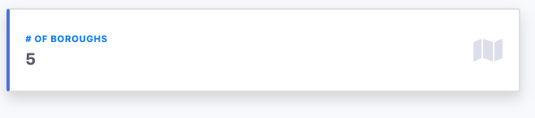
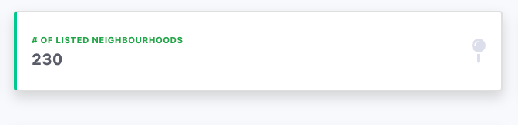
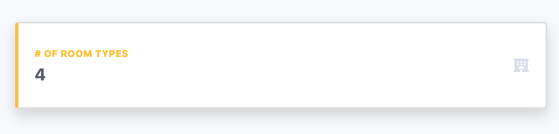
Summary of NYC Dataset
Notes:
- Our data reviewed each unique listing across 5 boroughs: The Bronx, Brooklyn, Manhattan, Queens and Staten Island.
After analyzing the data, we believed these listings would provide a true representative of Air BNB listings as it captured 230 out of 259 neighbourhoods in New York.
Room Types: Entire home/apartment, Private Room, Shared Room, Hotel Room

Slide 9
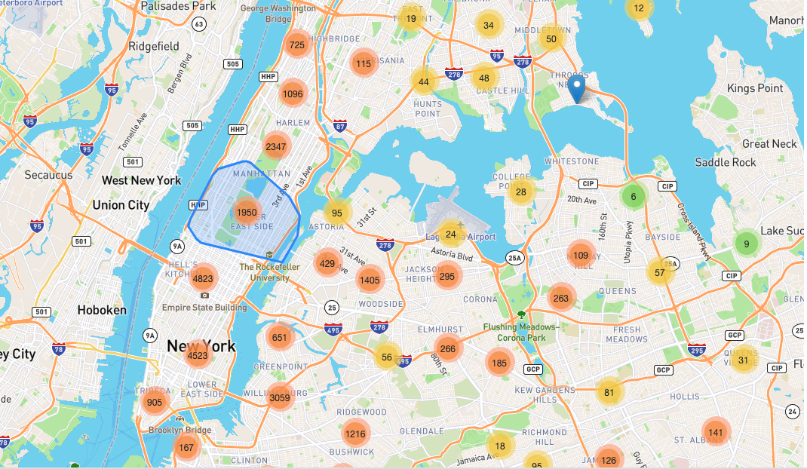
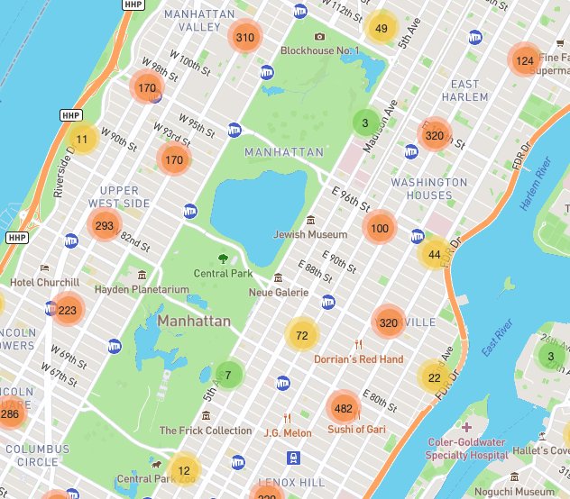
Property types available in NYC
Notes:
-To help users explore all listings available in NYC, we created a marker cluster map using Leaflet.
-The clusters display the number of listings with the different boroughs and neighbourhoods in NYC.
-In this example, we selected the the well-known New York borough of Manhattan, and then further zoomed in to the Upper West Side neighbourhood.

Slide 10
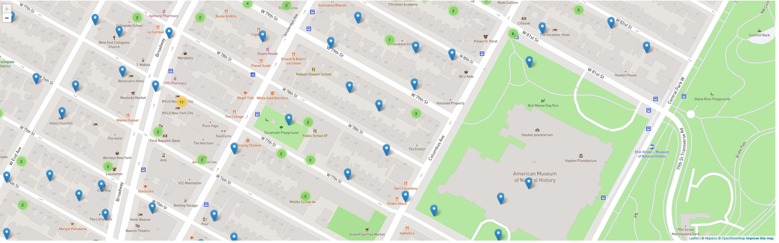

Property types available in NYC
Notes:
As you further zoom in, the clusters are further expanded to display individual listings using
a blue marker to help you specify an exact location within the neighbourhood.

Slide 11
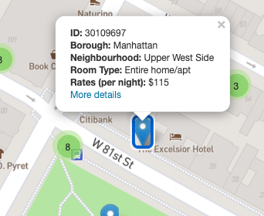
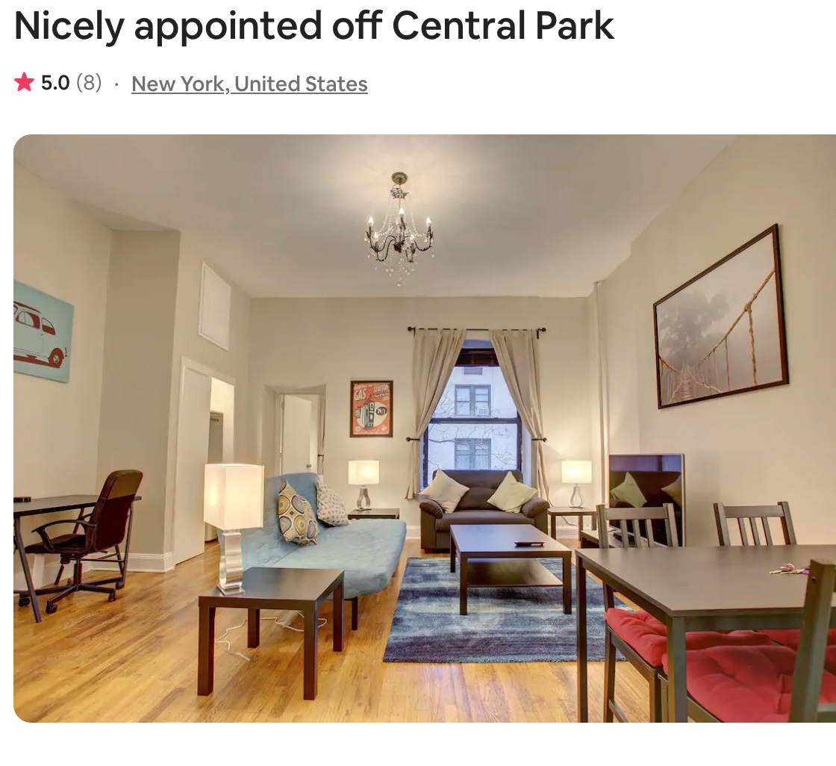
Property types available in NYC
Notes:
Clicking on the blue marker provides you with:
-Air Bnb Listing ID
-Borough/Neighbourhood
-Room Type
-Rates
-”More details” will take you to the Air BnB listing.

Slide 12
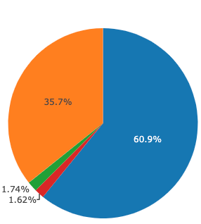
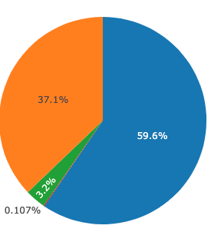
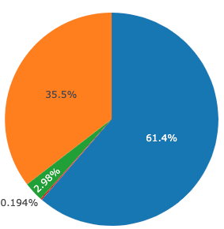
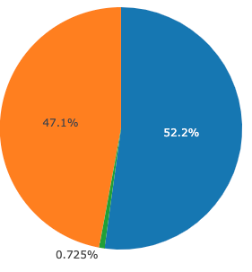
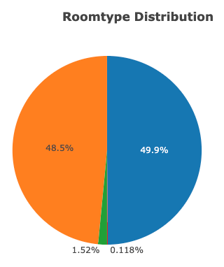
Property types available in NYC
Manhattan
Brooklyn
Bronx
Queens
Staten Island
Notes:
-For each borough, approximately 50% or more of listings were for an entire home/apartment. for a private room.
-Shared rooms are available sparsely across each borough.
-Very few hotels place listings on Air BnB. However, Manhattan had hotel rooms (1.6%) compared to the other boroughs that were all between 0.1% - 0.2%.
Legend:
- Entire home/apartment (Blue)
Private Room (Orange)
Shared Room (Green)
Hotel Room (Red)

Slide 13
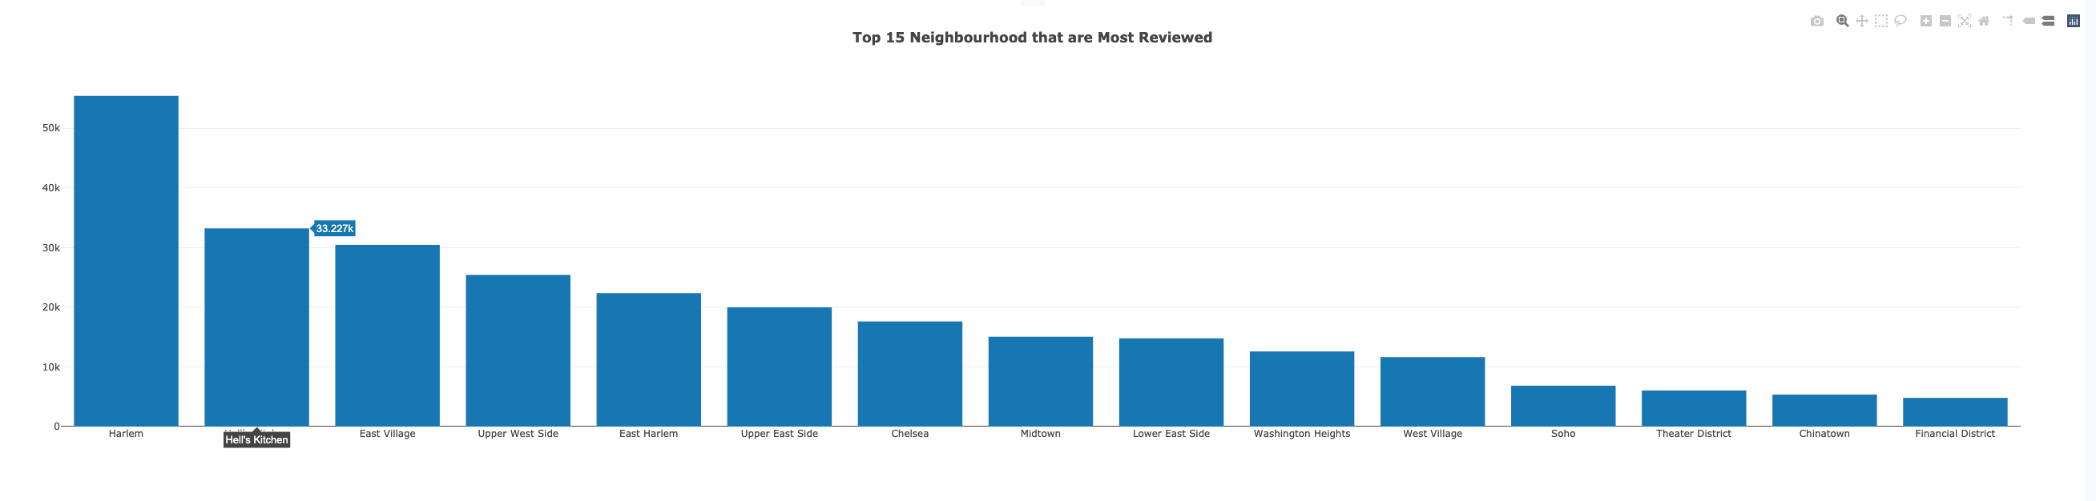
NYC Neighbourhood Ratings
Notes:
What neighbourhoods were highly rated by guests?
-We first looked into the top most most reviewed neighbourhoods to determine which were highly popular and typically chosen as a listing.
For each borough:
Manhattan -
Brooklyn -
Bronx -
Queens -
Staten Island -

Slide 14
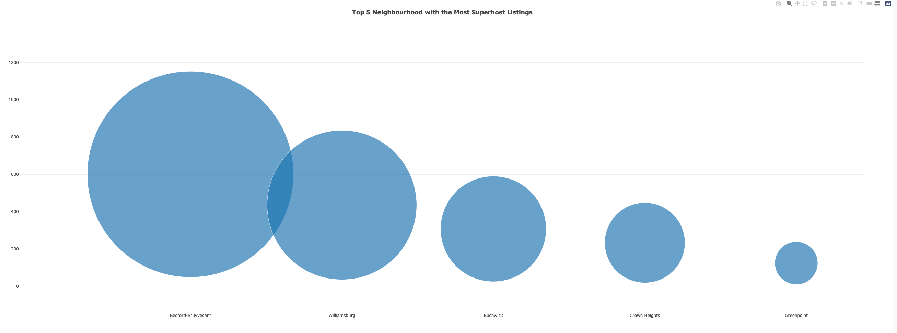
NYC Neighbourhood Ratings
Notes:
-Next, we looked into the neighbourhoods that had the most superhost listings available.
-As a background, to become a ‘superhost’ your listing must maintain an overall 4.8 rating within the past 365 days.
-Our analysis showed that the top favoured neighbourhoods were
Manhattan -
Brooklyn -
Bronx -
Queens -
Staten Island -
Superhost Requirements:
- Completed at least 10 trips OR completed 3 reservations that total at least 100 nights
Maintained a 90% response rate or higher
Maintained a 1% percent cancellation rate (1 cancellation per 100 reservations) or lower
Maintained a 4.8 overall rating (this rating looks at the past 365 days of reviews, based on the date the guest left a review, not the date the guest checked out)

Slide 15
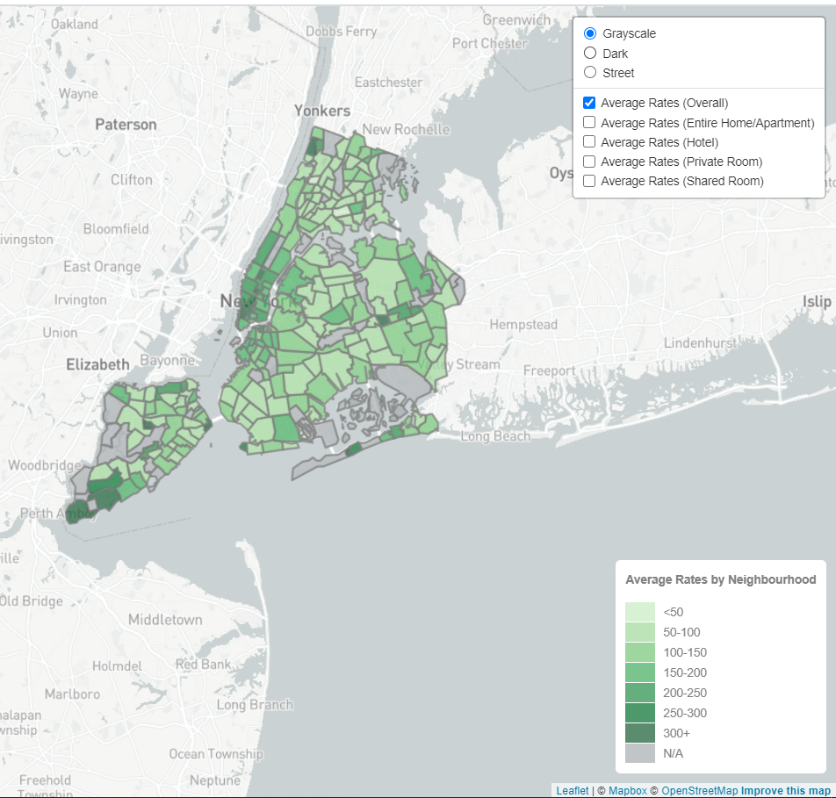
Pricing of NYC Neighbourhoods
Notes:
How do prices of listings vary by location?
To visualize pricing of the listings within NYC, we created a choropleth map using Leaflet. This visualization could be viewed in Greyscale, Dark, or Street Mode.
Users can find average rates according to the NYC neighbourhood and their desired room type.
The darker the shade of green, the more expensive the New York neighbourhood. Prices varied between less than $50 up to $1000 per night.
In this case:
Most expensive neighbourhoods:
Most affordable neighbourhoods:

Slide 16
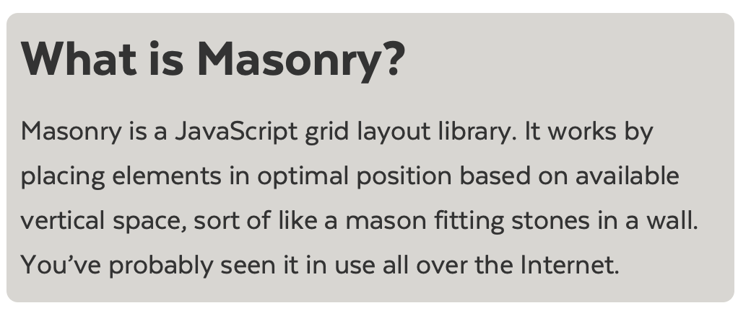

Dashboard Design
https://github.com/desandro/masonry
Notes:
-We found a new Javascript library called Masonry, and had planned to create a responsive layout.
-We found that it was not a good fit as our visualizations were not as effective.
***Create summary of new Javascript Library/difficulties
***Any html/bootstrap features

Slide 17
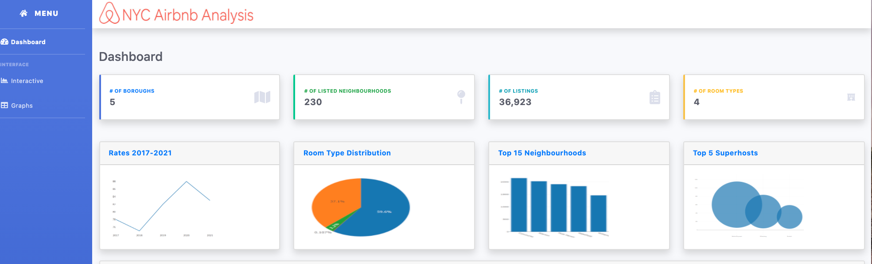
Dashboard Design
Notes:
Bootstrap template -

Slide 18
Next Steps…
A major area of concern for cities worldwide is the effect that expansion of Airbnb has made on the housing market for indigenous residents.
Further analysis can help determine if there is a correlation between Airbnb listings and rental/house prices for NYC neighbourhoods.

Slide 19

Q&A…

